Slide 1
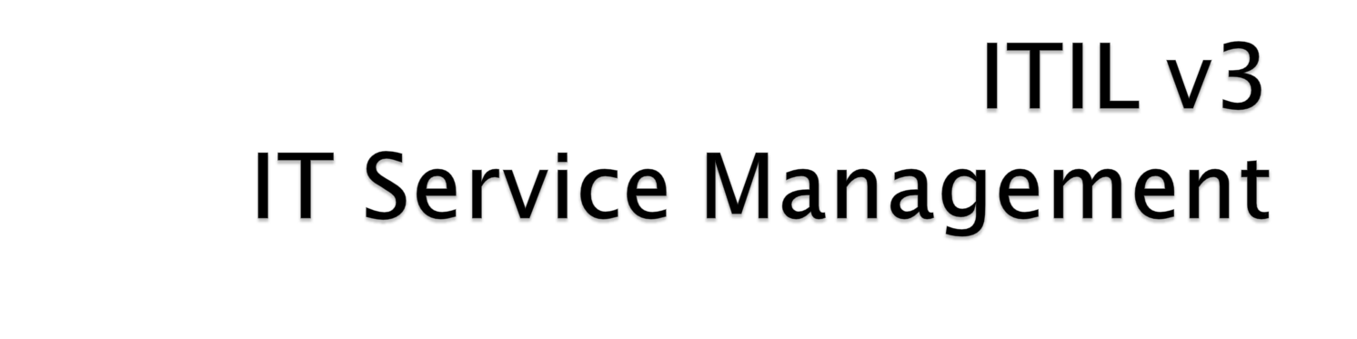

Slide <number>

Slide 2
  Global best practice for IT Service Management
  Provides a framework
  Supported by the itSMF
  First published by UK Government in the late 1980s
  Updated to v2 in 2000/2001
  Updated to v3 in 2007/2008
    A lifecycle model with more focus on strategy, business outcomes & business value
Slide <number>

Slide 3
  Designed around providing value to the business
  Aligned to ISO/IEC 20000 & other best practices
  Recognising that IT is a Strategic Business Unit
  Guidance on tool selection
  Industry and topic specific guidance
  Implementation guidance
  Integrated process maps
Slide <number>

Slide 4
Focus on the requirements of the University & not the technology
Implement Service Management best practice
Became part of the business planning process
Using an existing recognised framework (not “re-inventing the wheel”)
Introduction to IT Services of a service culture & increase in staff awareness of Service Management
Slide <number>

Slide 5
Commitment to continual service improvement & a service culture
Driving IT service delivery through process improvement & process implementation
Ability to measure Service Delivery to the University
Change Control/Management
To reduce the cost of “keeping the lights on”
Customer service is paramount – adding value to the Student Experience
Slide <number>

Slide 6
To become a process-based organisation and to “join up” existing processes
To manage Major Incidents
Reducing unplanned outages
Building relationships with all parts of the University – other service departments, faculties, schools, etc.
It is “Best Practice”
Slide <number>

Slide 7
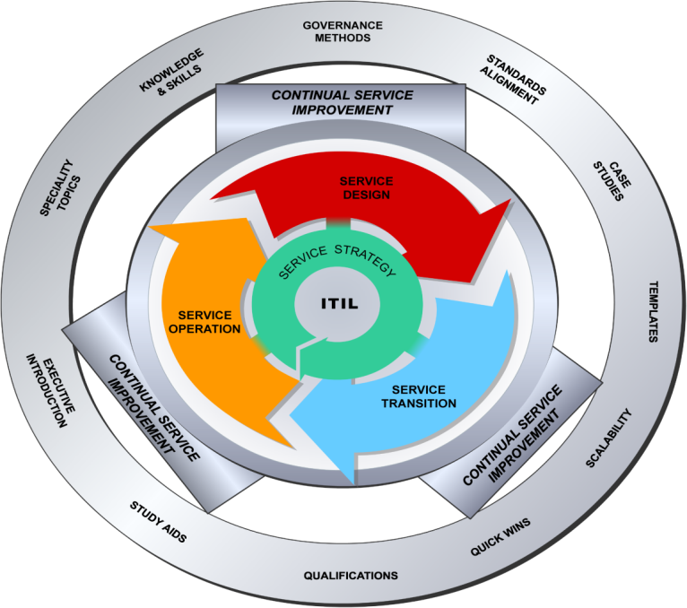
Slide <number>

Slide 8
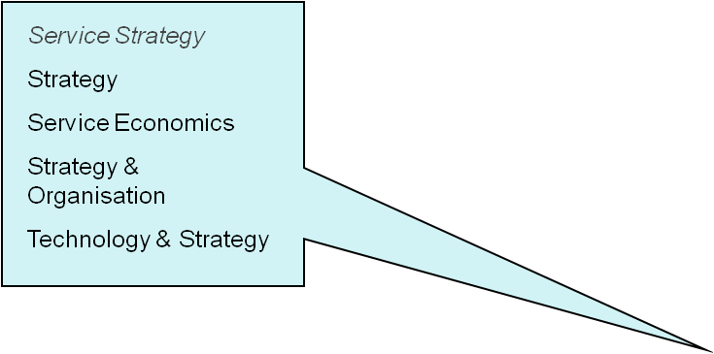

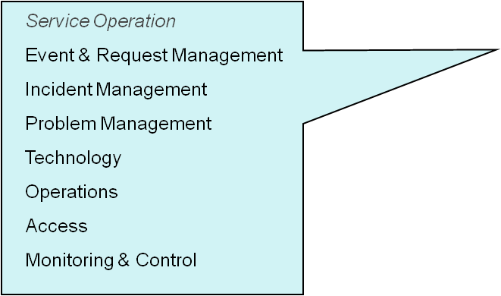
Continual Service Improvement
Measurement Trends Reporting & Analysis
Review Assessment Service Improvement
Service Design
Policy Planning & Implementation
Availability
Capacity
IT Service Continuity
Service Level Management
Outsource Design
Service Transition
Change Build & Test
Release & Deployment Management
Service Asset & Configuration Management
Knowledge Management
Slide <number>

Slide 9







Service Design – establish solutions to meet requirements
Service Transition –managing the transition through the lifecycle
Service Operation – day-to-day management of IT Services
Service Strategy – establishes an overall strategy for IT Services & ITSM
Continual Service Improvement – managing improvements to IT Services and ITSM Processes
Slide <number>

Slide 10
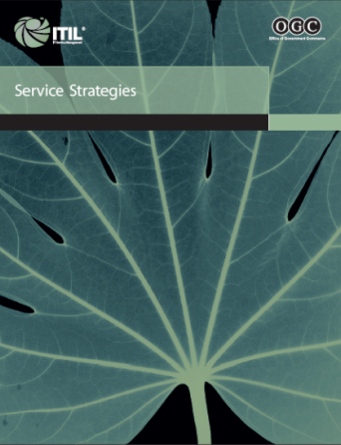
Alignment of new & changing services to University strategy
Supports business cases for investment
Resolves conflicting demands for services
Improves service quality by strategic planning
Ensures that Universities can manage the costs and risks associated with their Service Portfolios
Slide <number>
Notes:
Service Strategy offers a view of ITIL that aligns business and IT so that each brings out the best in the other. It ensures that every stage of the service lifecycle stays focused on the business case and relates to all the companion process elements that follow. Subsequent service lifecycle stages will link deliverables to meeting the business goals, requirements and service management principles described in this publication.
Concepts and guidance in this publication include:
Service Management strategy and value planning
Linking business plans and directions to IT service strategy
Planning and implementing service strategy

Slide 11
Agreeing service level agreements with internal faculties, schools & departments
Measuring IT quality in business/University terms
  Reduced total cost of ownership
  Improved quality/consistency of service
  Improved IT governance
  More effective Service Management
Slide <number>

Slide 12
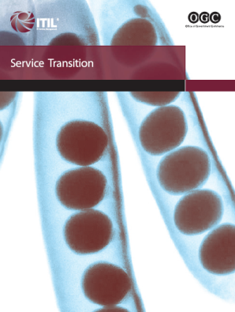
Align the new or changed service with the University’s requirements & business operations
Ability to adapt quickly to new service requirements
Improved success rate of changes
Improved organisational agility and flexibility
  Provides a consistent & rigorous framework for evaluating the service capability & risk before a new or changed service is released
Slide <number>
Notes:
Service Transition provides guidance and process activities for the transition of services in the operational business environment.
It covers the broader, long-term change management role, release and deployment practices, so that risks, benefits, delivery mechanisms and the support of ongoing operational services are considered.

Slide 13
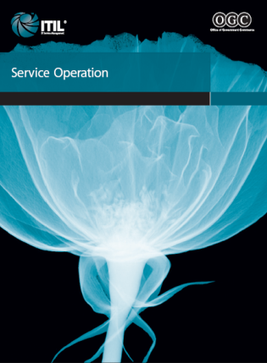
  Delivering & managing services at agreed levels to University customers & users
Management & monitoring of the technology that is used to deliver & support services
Management of Incidents, including Major Incidents, & ensuring recovery of service
Ensuring the appropriate IT organisation is in place to support the overall service requirements of the University
Cost-effective Service Delivery
Slide <number>
Notes:
Service Operation introduces, explains and details delivery and control activities to achieve operational excellence on a day-to-day basis. Readers will find many of the familiar processes from the former service support and service delivery books, which have been updated where necessary

Slide 14

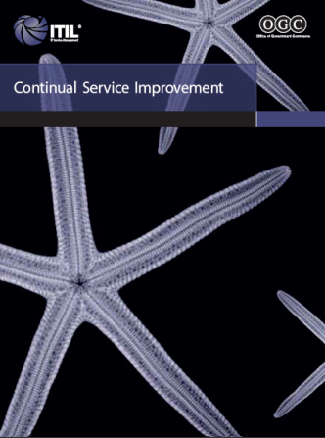

Commitment to ongoing service quality
Ongoing improvements to service & supporting processes
Review & implementation of appropriate University/business-focused service measures
ROI (Return on Investment)
VOI (Value on Investment)
Continual improvement becomes part of “Business as Usual”
Slide <number>
Notes:
Alongside the delivery of consistent, repeatable process activities as part of service quality, ITIL has always emphasised the importance of continual improvements.
Focusing on the process elements involved in identifying and introducing service management improvements, this publication also deals with issues surrounding service retirement.

Slide 15

Adoption rate of is rapidly increasing globally
Slide <number>

Slide 16

The University of Leeds
The University of Edinburgh
The University of Birmingham
The University of Nottingham
The University of Exeter
The University of Leicester
The University of Cardiff
Loughborough University
The University of Dundee
The University of Ulster
Huddersfield University
Sheffield Hallam University
Nottingham Trent University
Coventry University
Edinburgh Napier University
Slide <number>

Slide 17

EDS
Exxon
Federal Express
GE Capital
General Accident
J.D. Edwards & Company
KPMG
Legal & General Insurance
Merrill Lynch
Microsoft Corp.
Oracle
Hewlett Packard
UK Post Office
Procter & Gamble
Remedy Corp.
Royal Mail
Scottish Provident
Shell
Standard Life Assurance
The Equitable Insurance Company
Slide <number>

Slide 18

Develop a Vision & a Strategy
Communicate the Change Vision
Empower employees for broad-based action
Generate short-term wins
Anchor new approaches in the culture of the IT organisation
Management “buy-in”
ITIL® awareness & training
Don’t get stuck in the planning – do something!
Slide <number>

Slide 19

Repeatable, documented processes are essential to improving IT service delivery & management
The ITIL framework provides an effective foundation for quality IT service management
Slide <number>

Slide 20
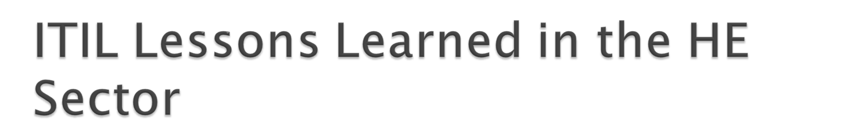
Buy-in from IT Senior Management, IT staff & any other key people / stakeholders is critical to overall success
Realistic understanding of the time taken to plan & implement ITIL® processes is needed
Resource required to carry out process development is an issue
Structure – understand what your structure should look like to support the appropriate processes & roles
Slide <number>

Slide 21
Focus on the development of the IT organisation required to support Service Management
Have dedicated roles rather than part time – i.e. Change Manager
Don’t do ITIL® from the book – it needs to be adapted to the organisation
Communication is key at all stages
Don’t underestimate the internal effort in changing to a new Service Management tool
Slide <number>

Slide 22
Investment – there has to be some budget – ITIL® training (the common message) & the development of process (backfill for resource)
Consider placing all Support Teams under central management – this leverages synergies & is more cost effective
ITIL® “is a journey not a destination”
Requires commitment as the payback is not immediate & may not be seen for a couple of years
Slide <number>

Slide 23
Launch sooner! Don’t spend months & months planning – it is better to get started & deliver something!
Time pressures – it took much longer than originally planned/anticipated – be realistic with the timescales
Engage with those who will be involved in the process – this ensures “buy-in” at all levels & ensures contribution/collaboration in the process development
Slide <number>

Slide 24
Reduced cost of “Business as Usual”
Reduced effort involved in “keeping the lights on”
Delivery of quality service which fits the requirements of the University
Improved availability/reliability of services
Helped establish better relationships across IT & the University
Introduction of a service culture
Slide <number>

